Slide 1
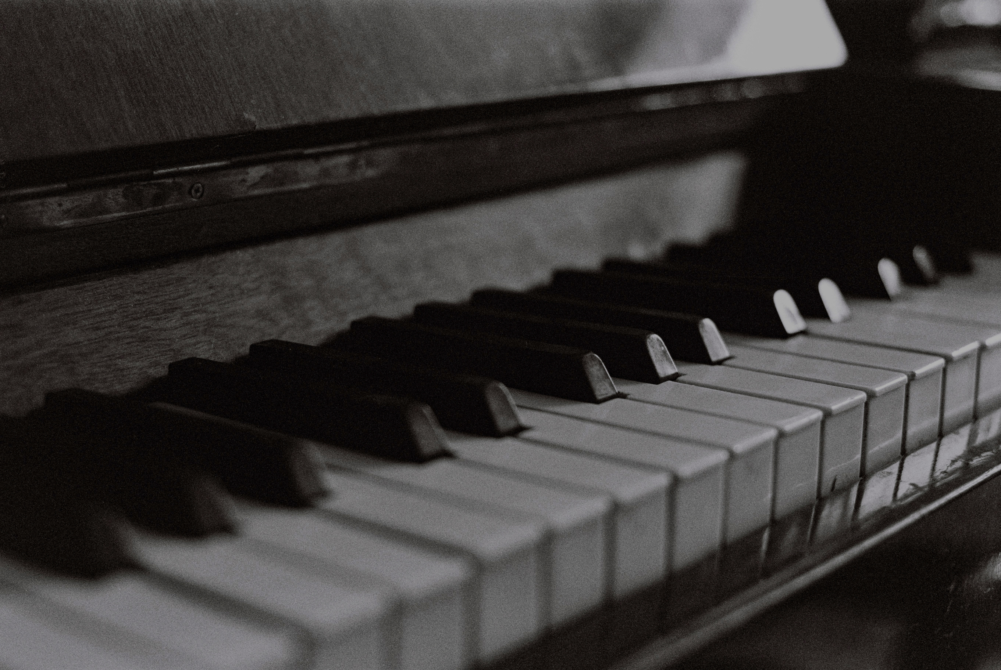

AMAZON MUSIC CLUSTERING
Page | 01

Slide 2
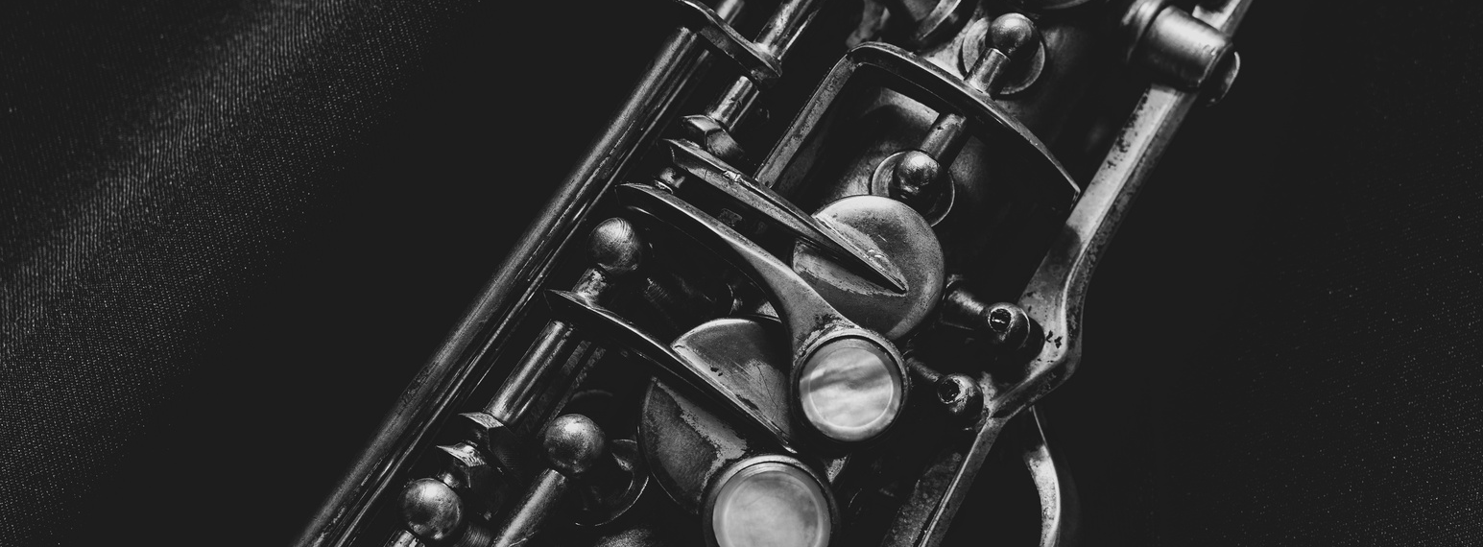

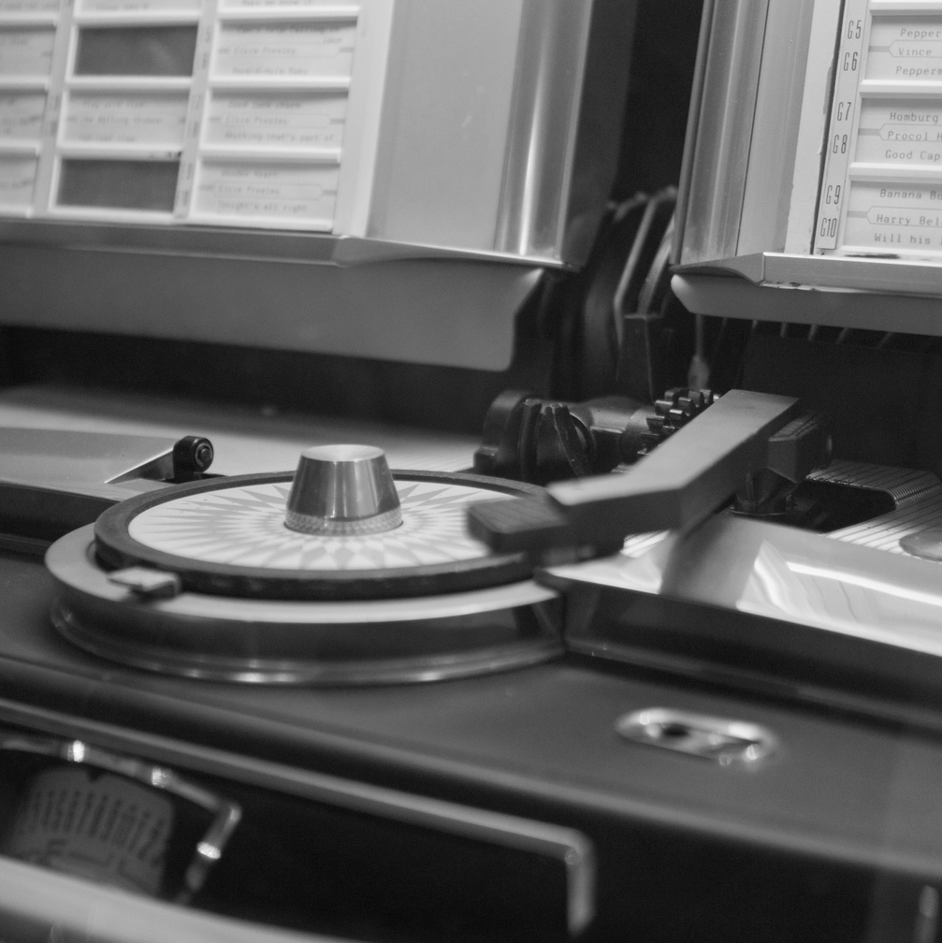
PROBLEM STATEMENT
How can we automatically group songs with similar audio characteristics into clusters (potentially representing genres or moods), without relying on manual genre labels?
Page | 02

Slide 3

BUSINESS USE CASES
Personalized Playlist Curation – Auto-generate playlists of similar-sounding tracks.
Improved Song Discovery – Suggest similar tracks based on user preferences.
Artist Analysis – Help artists identify competitors with similar sound profiles.
Market Segmentation – Enable streaming platforms to analyze listening trends.
Page | 03

Slide 4
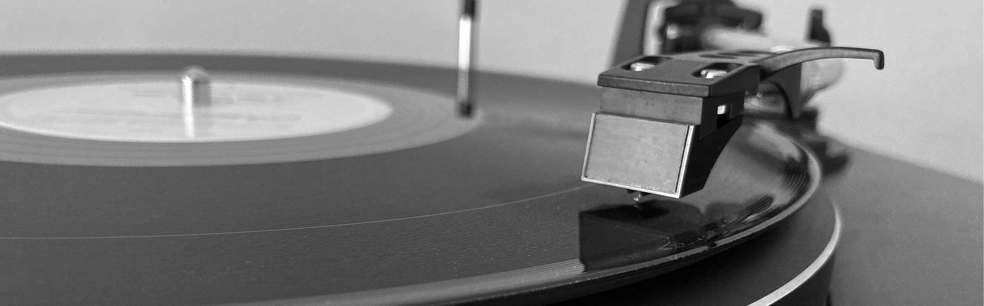

1. Data Exploration & Preprocessing
Load dataset: single_genre_artists.csv
Explore structure: columns, datatypes, nulls, duplicates
Drop unnecessary columns: track_id, track_name, artist_name
Normalize features using StandardScaler / MinMaxScaler
APPROACH
Page | 04

Slide 5
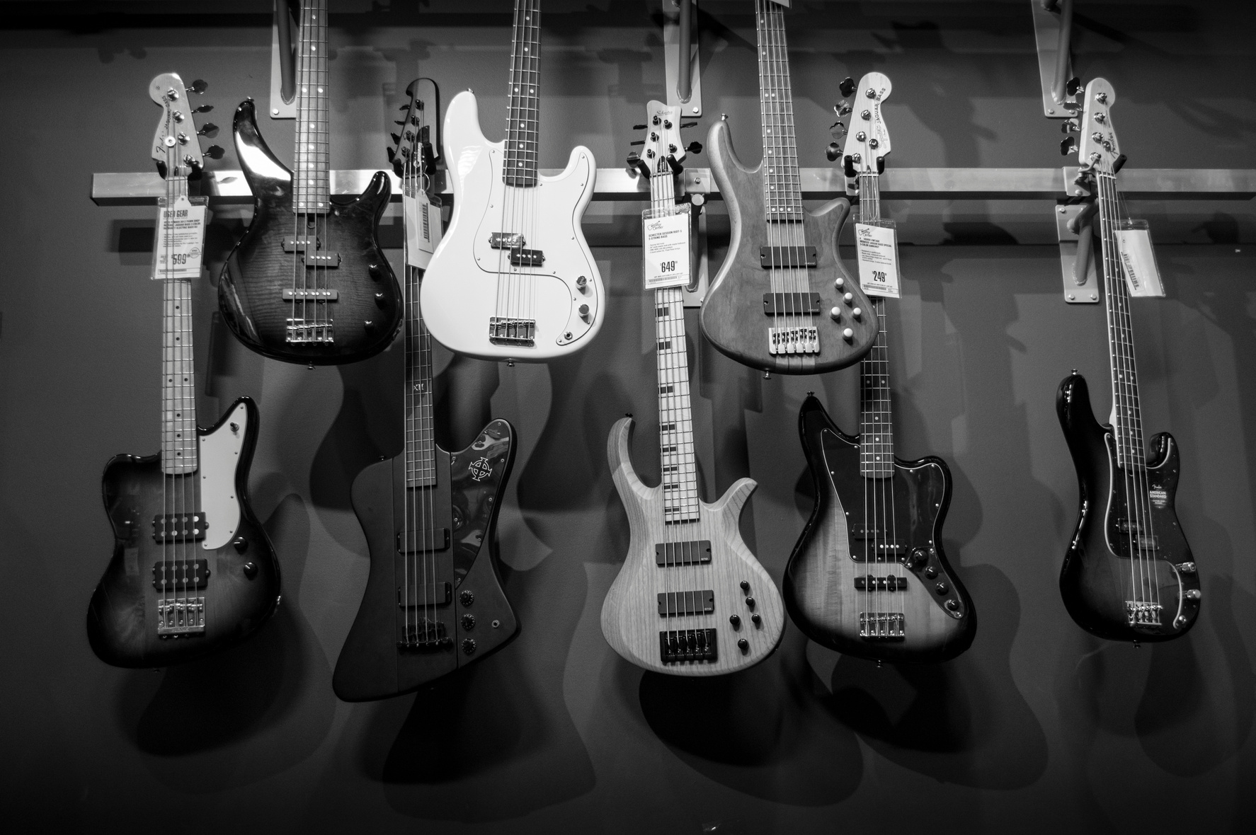

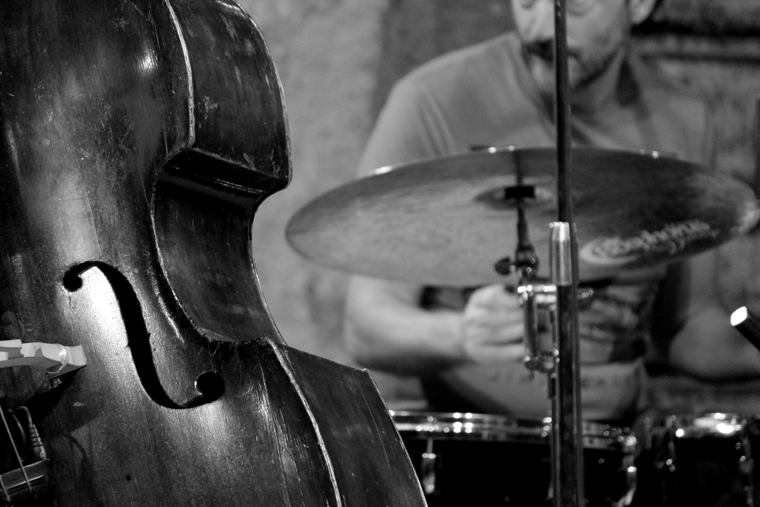
Studio Shodwe
2. Feature Selection
Selected features for clustering:
danceability, energy, loudness, speechiness,
acousticness, instrumentalness, liveness, valence,
tempo, duration_ms
Page | 05

Slide 6

3.Clustering Techniques
K-Means → Find k using Elbow Method & Silhouette Score
DBSCAN → Detect arbitrary-shaped clusters, noise/outliers
Hierarchical Clustering → Visualize merging via dendrogram
4.Cluster Evaluation
Silhouette Score – Cluster separation
Davies-Bouldin Index – Intra-cluster similarity
Inertia – Compactness of clusters
Page | 06

Slide 7


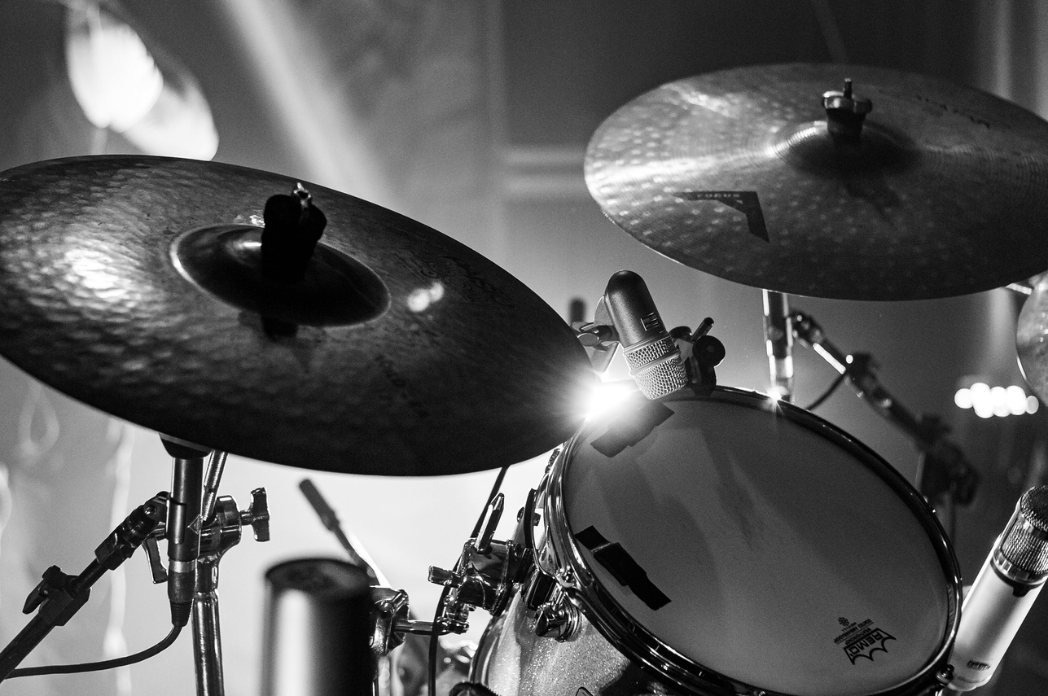

5. VISUALIZATION
2D scatter plots (PCA/t-SNE, color-coded clusters)
Bar charts → avg feature values per cluster
Heatmaps → feature comparisons
Distribution plots → tempo, danceability, etc.
Page | 07

Slide 8

6. FINAL ANALYSIS
Add cluster labels to dataset
Profile clusters (e.g., high energy + danceability = Party tracks)
Export clustered dataset as CSV
Write a summary of cluster insights
Page | 09

Slide 9
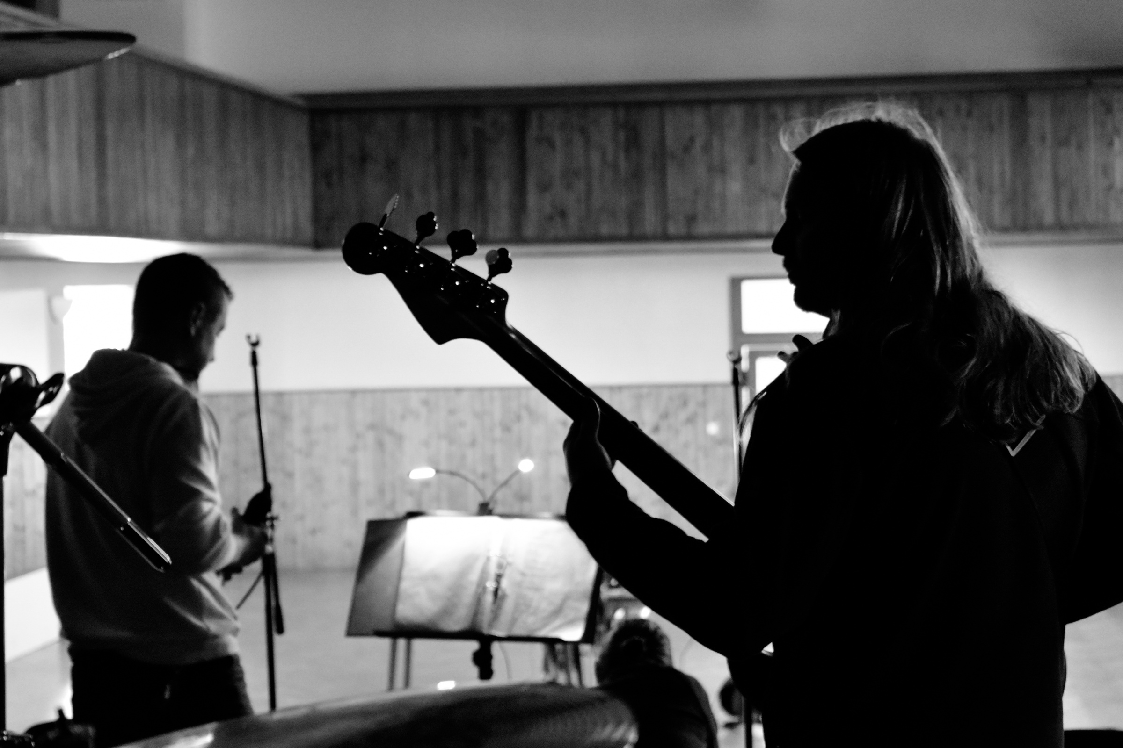

THANK YOU
Page | 10

